Slide 1
STOR 455 Class 37
Read: 8.7, 8.8
Exercises: 8.51, 53, 55, 59, 61

Slide 2
What’s an Interaction Effect?
An interaction effect occurs when a significant difference is present at a specific combination of factors.
Example: Y=GPA
Factor A = Year in School (FY, So, Jr, Se)
Factor B = Major (Psych, Bio, Math)
FY is hard
⇒ α₁ < 0 (main effect)
Bio is easy
⇒ β₂ > 0 (main effect)
Jr in Math is hard
⇒ γ₃₃ < 0 (interaction effect)

Slide 3
Factorial Design
Assume: Factor A has K levels, Factor B has J levels.
To estimate an interaction effect, we need more than one data value in each combination of factors.
Let n_{kj} = sample size in (k,j)^{th} cell
Def: For a balanced design, n_{kj} is constant for all cells.
c = 1 ⇒ randomized block design
c > 1 ⇒ balanced factorial design
n_{kj} = c

Slide 4
Example: Glue Strength
Factor A: Thickness (thin, moderate, heavy)
Factor B: Glue Type (plastic, wood)
Response: Force required to separate parts (newtons)
Data: | Plastic | Wood
Thin | 52 64 | 72 60
Moderate | 67 55 | 78 68
Heavy | 86 72 | 43 51
K= 3
J = 2
c = 2
n = 12

Slide 5
Two-way ANOVA Table (with interaction)
Source | d.f. | S.S. | M.S. | t.s. | p-value
Factor A | K-1 | SSA | SSA/(K-1) | MSA/MSE
Factor B | J-1 | SSB | SSB/(J-1) | MSB/MSE
A x B | (K-1)(J-1) | SSAB | SSAB/df | MSAB/MSE
Error | JK(n-1) | SSE | SSE/df
Total | n-1 | SSY
H_{o}: All α_{k} = 0
H_{A}: Some α_{k} ≠ 0
H_{o}: All β_{J} = 0
H_{A}: Some β_{J} ≠ 0
H_{o}: All γ_{kj} =0
H_{A}: Some γ_{kj} ≠ 0

Slide 6
Two-way ANOVA Table (with interaction)
Source | d.f. | S.S. | M.S. | t.s. | p-value
Factor A | 2 | 56 | 28.0 | 0.42 | 0.672
Factor B | 1 | 48 | 48.0 | 0.73 | 0.426
A x B | 2 | 1184 | 592.0 | 8.97 | 0.016
Error | 6 | 396 | 66.0
Total | 11 | 1684
H_{o}: All α_{k} = 0
H_{A}: Some α_{k} ≠ 0
H_{o}: All β_{J} = 0
H_{A}: Some β_{J} ≠ 0
H_{o}: All γ_{kj} =0
H_{A}: Some γ_{kj} ≠ 0
No main effects, but there is some interaction effect.

Slide 7
Interpreting Interaction
IF the two-way ANOVA indicates a significant interaction, plot the cell means vs. one factor with separate lines/symbols for the second factor
Called a Cell means plot or Interaction plot
Cell Means: | Plastic | Wood
Thin | 58.0 | 66.0
Moderate | 61.0 | 73.0
Heavy | 79.0 | 47.0
interaction.plot(FactorA,FactorB,Response)

Slide 8
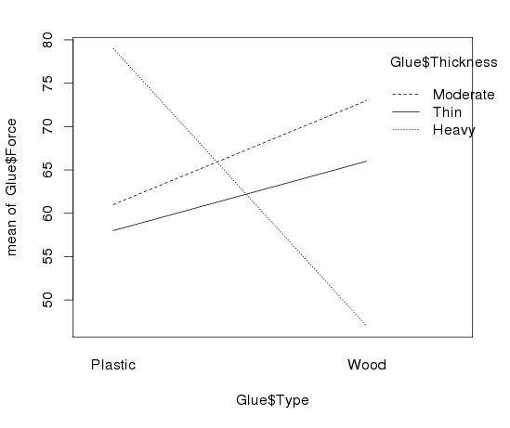
Interaction Plot via R
> interaction.plot(Glue$Type,Glue$Thickness,Glue$Force)
> interaction.plot(FactorA,FactorB,Y)

Slide 9
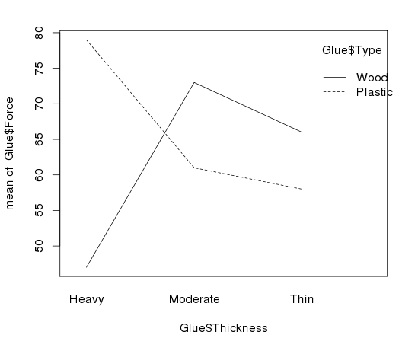
> interaction.plot(Glue$Thickness,Glue$Type,Glue$Force)

Slide 10
The Diet data set contains information on 78 people using one of three diets
Variable name | Variable
Person | Participant number
Sex | 1 = male, 0 = female
Age | Age (years)
Height | Height (cm)
preweight | Weight before the diet (kg)
Diet | Diet
weight6weeks | Weight after 6 weeks (kg)
Investigate the data to determine the impact of the type of diet and sex on mean weight loss in a two-way model with an interaction.
Evaluate the residuals for the appropriateness of using the two-way ANOVA model with an interaction.
Use pairwise methods to investigate differences between means if the overall ANOVA model is significant.

Slide 11
ANOVA via Dummy Regression
Recall: For a single categorical factor with K levels
Create K-1 indicator (dummy) predictors
Run regression with the dummy predictors
Constant estimates the mean of the reference group
Coefficients estimate how each other group differs
ANOVA tables match (depending…)

Slide 12
Main Effects Two-way ANOVA via Dummy Regression
Create indicator predictors for each factor
Run regression with the dummy predictors (leaving out one for each factor)
How to interpret the coefficients?
How to “recover” the two-way ANOVA table?

Slide 13
Two-way ANOVA w/Interaction via Dummy Regression
Create indicator predictors for each factor
Run regression with the dummy predictors (leaving out one for each factor)
To include interaction: Use products of the (included) dummies.
How to interpret the coefficients?
How to “recover” the three ANOVA components?

Slide 14
Dummy Regression for Two-way ANOVA output
mod6=lm(Force ~ Thickness + Type + Type*Thickness, data = Glue)
summary(mod6)
Estimate Std. Error t value Pr(>|t|)
(Intercept) 79.000 5.745 13.752 9.19e-06 ***
Thicknessmoderate -18.000 8.124 -2.216 0.06861 .
Thicknessthin -21.000 8.124 -2.585 0.04149 *
Typewood -32.000 8.124 -3.939 0.00763 **
Thicknessmoderate:Typewood 44.000 11.489 3.830 0.00866 **
Thicknessthin:Typewood 40.000 11.489 3.482 0.01312 *
---
Signif. codes: 0 ‘***’ 0.001 ‘**’ 0.01 ‘*’ 0.05 ‘.’ 0.1 ‘ ’ 1
Residual standard error: 8.124 on 6 degrees of freedom
Multiple R-squared: 0.7648, Adjusted R-squared: 0.5689
F-statistic: 3.903 on 5 and 6 DF, p-value: 0.06386
Means | Plastic | Wood
Thin | 58.0 | 66.0 | 62.0
Moderate | 61.0 | 73.0 | 67.0
Heavy | 79.0 | 47.0 | 63.0
 | 66.0 | 62.0 | 64.0

Slide 15
KEY POINT
It’s all just multiple regression!

Slide 16
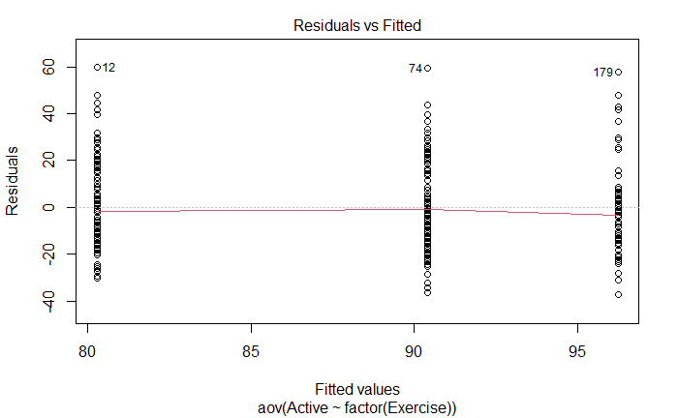
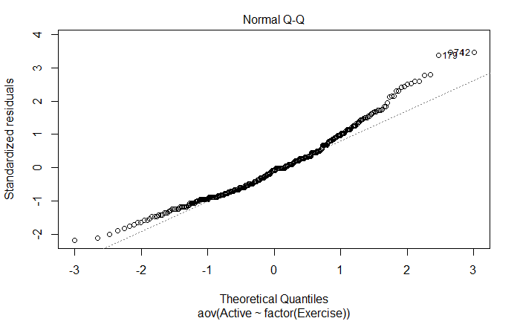
One Way ANOVA – Pulse
> modp = aov(Active~factor(Exercise), data = Pulse)
> summary(modp)
Df Sum Sq Mean Sq F value Pr(>F)
factor(Exercise) 2 14342 7171 24.02 1.54e-10 ***
Residuals 372 111050 299
> plot(modp)

Slide 17
Analysis of Covariance (ANCOVA)
Basic idea: If we can use dummy predictors to convert an ANOVA for means into a regression model, why not also include quantitative predictors?
Example (pulse rates):
Active = β₀ + β₁Rest + β₂Exer1 + β₃Exer2 + ε
Covariate
Factor

Slide 18
ANCOVA – Pulse
> modp2 = lm(Active~Rest + factor(Exercise), data = PulseF17)
> anova(modp2)
Response: Active
Df Sum Sq Mean Sq F value Pr(>F)
Rest 1 50342 50342 250.0302 <2e-16 ***
factor(Exercise) 2 351 175 0.8714 0.4192
Residuals 371 74699 201
Are the conditions still met?

Slide 19
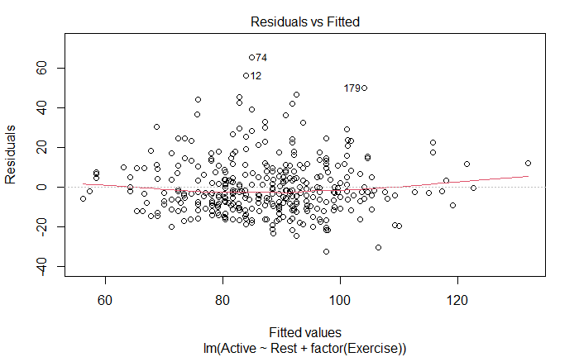
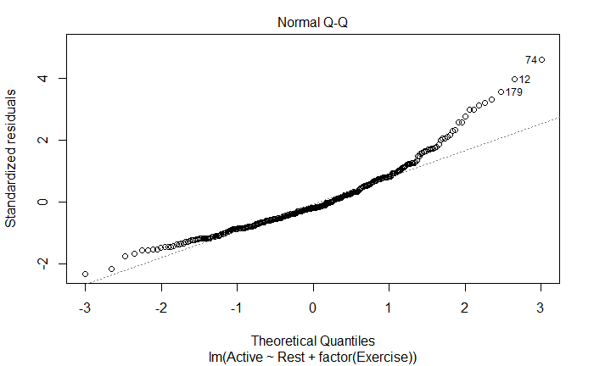
ANCOVA – Pulse
> plot(modp2)
Are the conditions still met? Maybe not…

Slide 20
ANCOVA Condition – Pulse
New condition to consider: Is there an interaction between the covariate and the factor?
> Exercise1 = subset(Pulse, Pulse$Exercise==1)
> Exercise2 = subset(Pulse, Pulse$Exercise==2)
> Exercise3 = subset(Pulse, Pulse$Exercise==3)
> lme1 = lm(Active ~ Rest, data=Exercise1)
> lme2 = lm(Active ~ Rest, data=Exercise2)
> lme3 = lm(Active ~ Rest, data=Exercise3)
> plot(Active ~ Rest, data=Pulse)
> abline(lme1)
> abline(lme2, col='red')
> abline(lme3, col='blue')

Slide 21
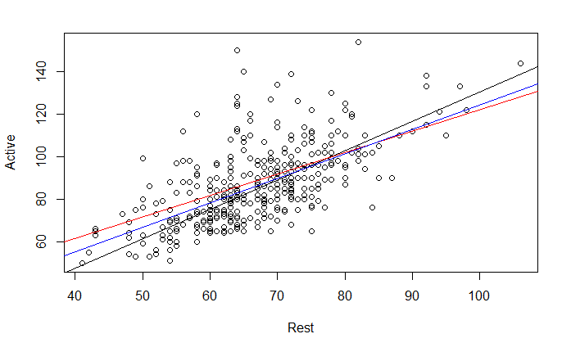
ANCOVA Condition – Pulse
New condition to consider: Is there an interaction between the covariate and the factor?
The slopes seem similar, so there is likely no interaction

Slide 22
ANCOVA – Pulse
plot(modp2, 2)
Will a transformation help?

Slide 23
ANCOVA – PulseF17
> modp2log = lm(log(Active)~log(Rest) + factor(Exercise), data = Pulse)
> anova(modp2log)
Response: log(Active)
Df Sum Sq Mean Sq F value Pr(>F)
log(Rest) 1 6.7174 6.7174 277.991 <2e-16 ***
factor(Exercise) 2 0.0499 0.0250 1.033 0.3569
Residuals 371 8.9648 0.0242
Are the conditions met now?

Slide 24
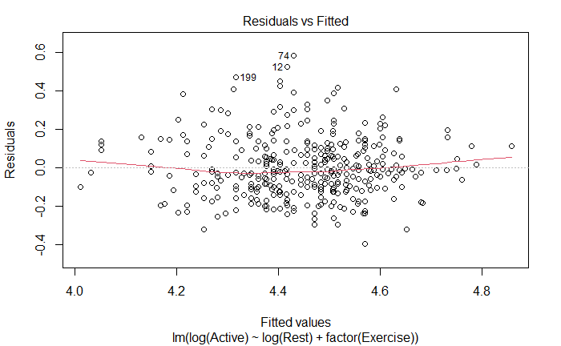
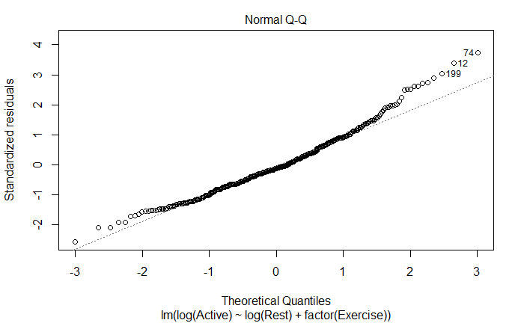
ANCOVA – Pulse
plot(modp2log, 1:2)
Are the conditions still met? Much better.

Slide 25
ANCOVA Condition – Pulse
Is there an interaction between the covariate and the factor?
> lme1.log = lm(log(Active) ~ log(Rest), data=Exercise1)
> lme2.log = lm(log(Active) ~ log(Rest), data=Exercise2)
> lme3.log = lm(log(Active) ~ log(Rest), data=Exercise3)
> plot(log(Active) ~ log(Rest), data=Pulse)
> abline(lme1.log)
> abline(lme2.log, col='red')
> abline(lme3.log, col='blue')

Slide 26
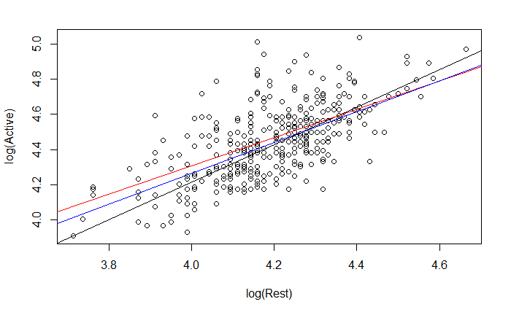
ANCOVA Condition – PulseF17
Is there an interaction between the covariate and the factor?
The slopes still seem similar, so there is likely no interaction

Slide 27
ANCOVA – Pulse
> modp2log = lm(log(Active)~log(Rest) + factor(Exercise), data = PulseF17)
> anova(modp2log)
Response: log(Active)
Df Sum Sq Mean Sq F value Pr(>F)
log(Rest) 1 6.7174 6.7174 277.991 <2e-16 ***
factor(Exercise) 2 0.0499 0.0250 1.033 0.3569
Residuals 371 8.9648 0.0242
What does this tell us?

Slide 28
The Diet data set contains information on 78 people using one of three diets
Variable name | Variable
Person | Participant number
Sex | Sex, 1 = male, 0 = female
Age | Age (years)
Height | Height (cm)
Preweight | Weight before the diet (kg)
Diet | Diet
weight6weeks | Weight after 6 weeks (kg)
After accounting for Age and Height, does the type of the diet significantly predict the weight loss?

Slide 29
Analysis of Covariance (ANCOVA)
Example (diet):
WeightLoss = β₀ + β₁Age + β₂Height + β₃Diet1 + β₄Diet2 + ε
Covariates
Factor
After accounting for Age and Height, does the type of the diet significantly predict the weight loss?

Slide 30
ANCOVA – Diet
Diet$weightchange = Diet$weight6weeks - Diet$Preweight
mod8=lm(weightchange ~ Age + Height + factor(Diet), data=Diet)
anova(mod8)
Response: weightloss
Df Sum Sq Mean Sq F value Pr(>F)
Age 1 1.69 1.689 0.2870 0.593795
Height 1 6.23 6.227 1.0580 0.307068
factor(Diet) 2 63.68 31.838 5.4092 0.006448 **
Residuals 73 429.68 5.886
What does this tell us?

